Slide 1

B.Tech Project External Evaluation, VIIIth Sem e-Farmer
Presented by:-
Gauri Shankar Singh, 2018008774
Simpi Raj, 2018015533
Sonali Kumari, 2018011388
Priyambda Arya, 2018016351
Under the Supervision of:-
Dr. Vijendra Singh
Sharda University, Gr. Noida
DEPARTMENT OF COMPUTER SCIENCE & ENGINEERING
SCHOOL OF ENGINEERING AND TECHNOLOGY
10, May, 2022

Slide 2
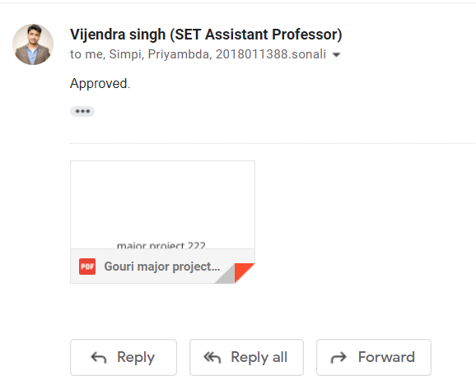
Approval from guide for the evaluation

Slide 3
Contents:
Project Overview
Workload distribution of the team
Improvement/Work done from the last evaluation
Proof of paper accepted or communicated
Flow diagram of disease detection
Tools
Methods
Screen Shots of the implementation part
Conclusion

Slide 4
Project overview:
The e-Farmer is a website where farmers can find information about diseases on their crops. They have to upload images of the leaf and then they will get the disease information. Here, we are covering 6 types of species like Apple, Potato, Tomato, Maize, Peach, and Cherry.
We offer live chat so that we can answer all of the questions that farmers may have.
This website will be available in local languages so every farmer can easily use the website.

Slide 5
Workload distribution of the team
Front-end – Sonali Kumari, Priyambda Arya
Data Training –Gauri Shankar Singh
Back-end – Gauri Shankar Singh, Simpi Raj

Slide 6
Improvement/Work done from the last evaluation
Our research paper is completed and submitted to the IEEE International Conference on Emerging Trends in Engineering and Technology SIP-22, where it is accepted.
We have tested our pre-trained model.
We have designed the front-end for our project
The front end was combined with a pre-trained model.

Slide 7
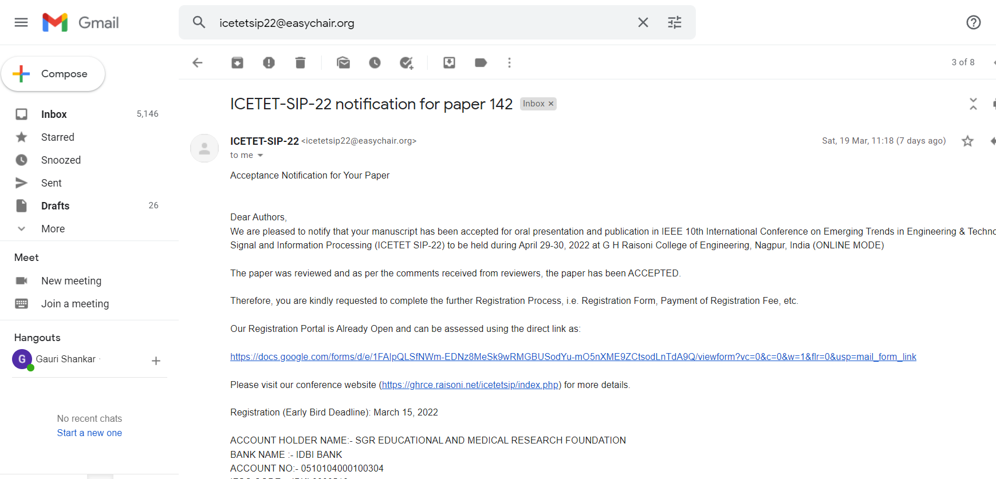
Proof of paper accepted or communicated/ Hackathon/ Patent

Slide 8
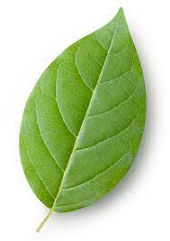

Flow diagram of disease detection
scaled to 256x256
Extract Features
Trained Model
Disease detection in leaf

Slide 9
Tools
IDE (VS Code, Jupyter Notebook)-VS Code is a source code editor and it is used to develop the frontend and backend. And Jupyter Notebook is used to train data with different algorithms.
Amazon Web Services (AWS)- AWS is a cloud platform that provides servers, storage, development, and security, we are using AWS for hosting our website.
Flask- Flask is a Python framework for building web applications, and we used it to combine our front-end with a pre-trained model.

Slide 10
Methods
We have trained our data with many different algorithms like CNN 3 layers, Inception V3, DenseNet-121, achieved good accuracy with all algorithms, and we used the DenseNet-121 model to test.
We have designed the Front-end with multiple functions like live chat, crop information by using HTML, CSS, JS.
Combined our pre-trained model with the front-end with help of a flask.
We tested the project on a local server, and the prediction accuracy was very accurate.
Now we will host our website on Amazon Web Services (AWS).

Slide 11
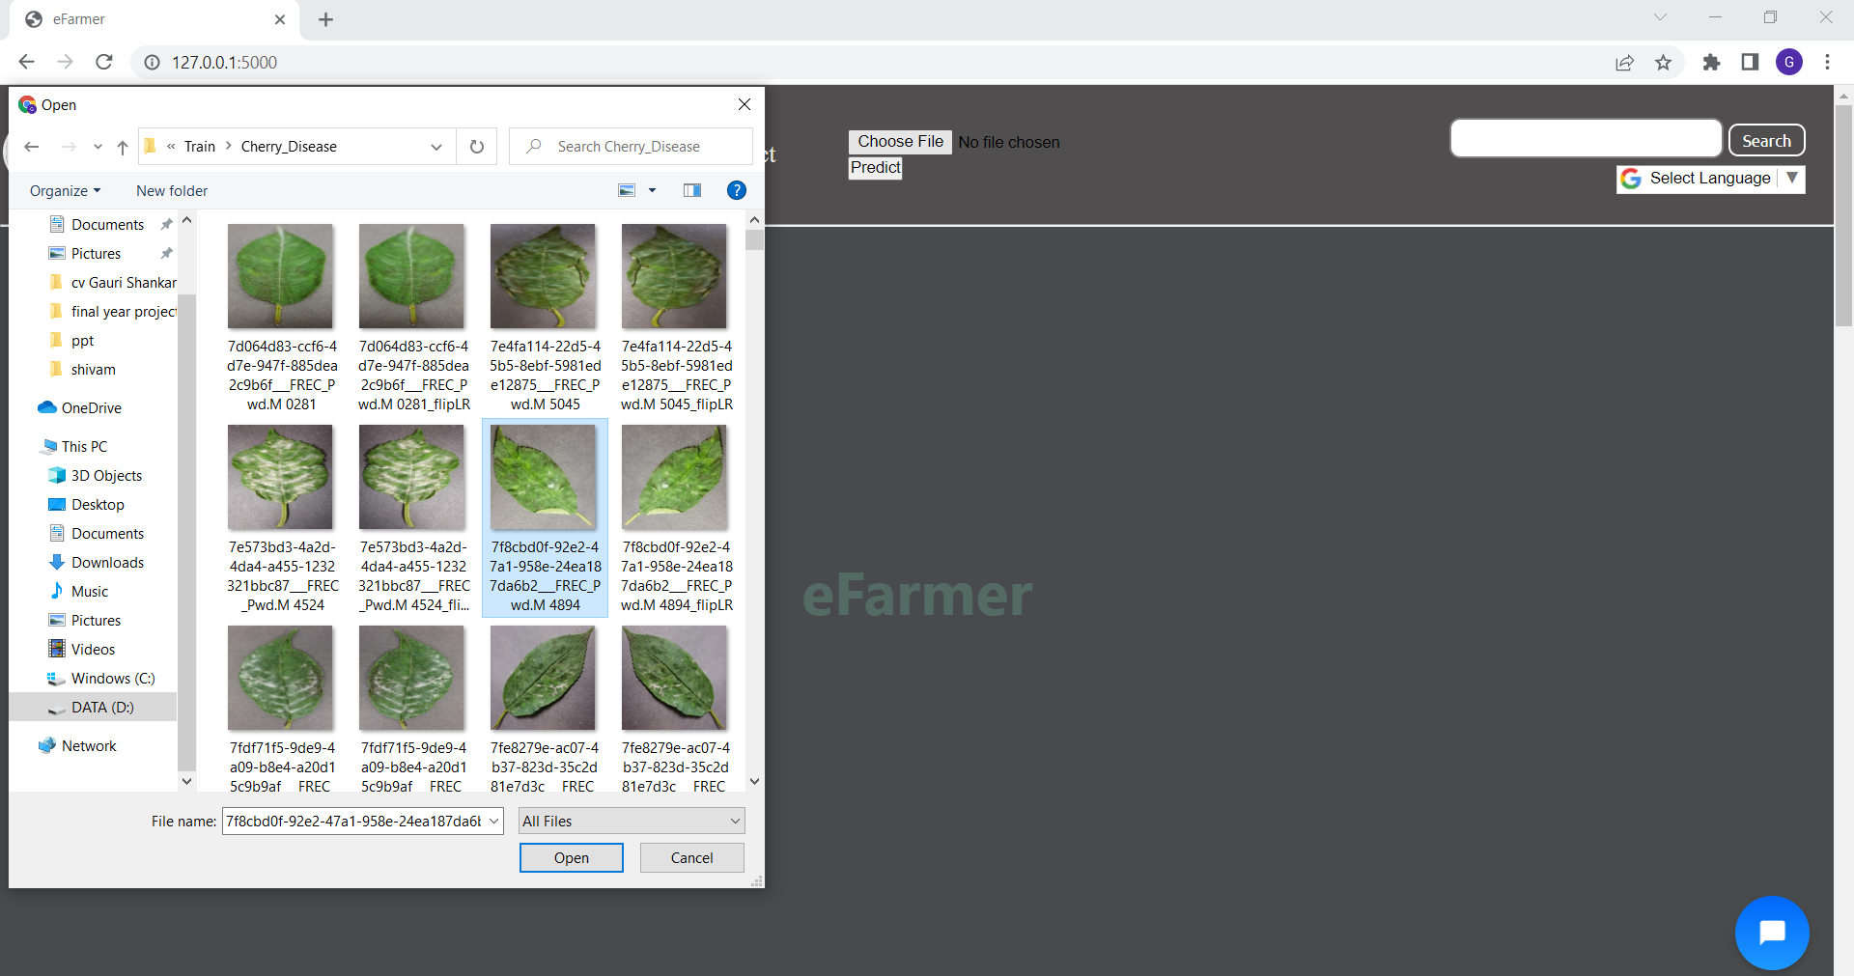
Select image of leaf for input

Slide 12
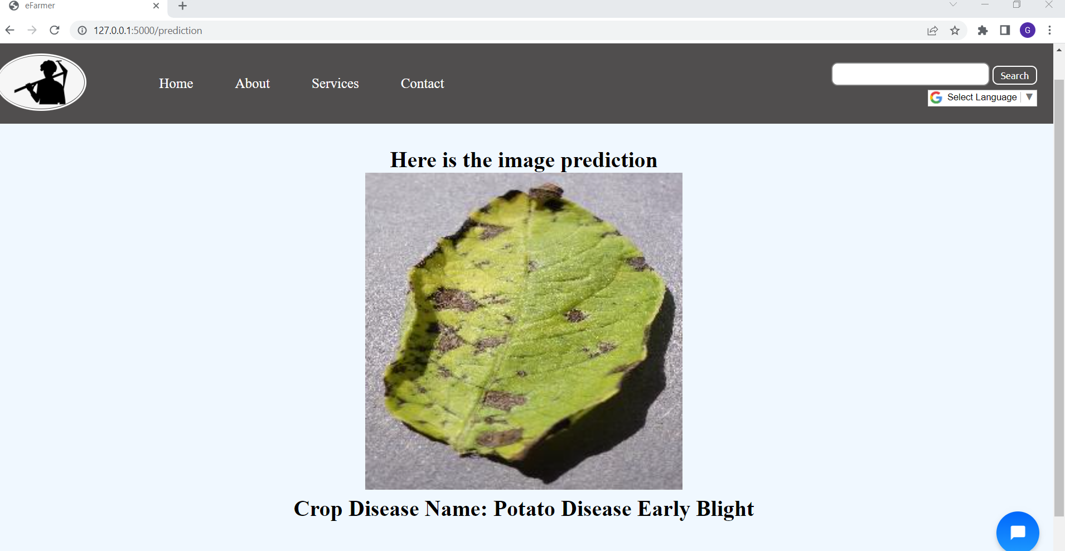
Output (leaf detected)

Slide 13
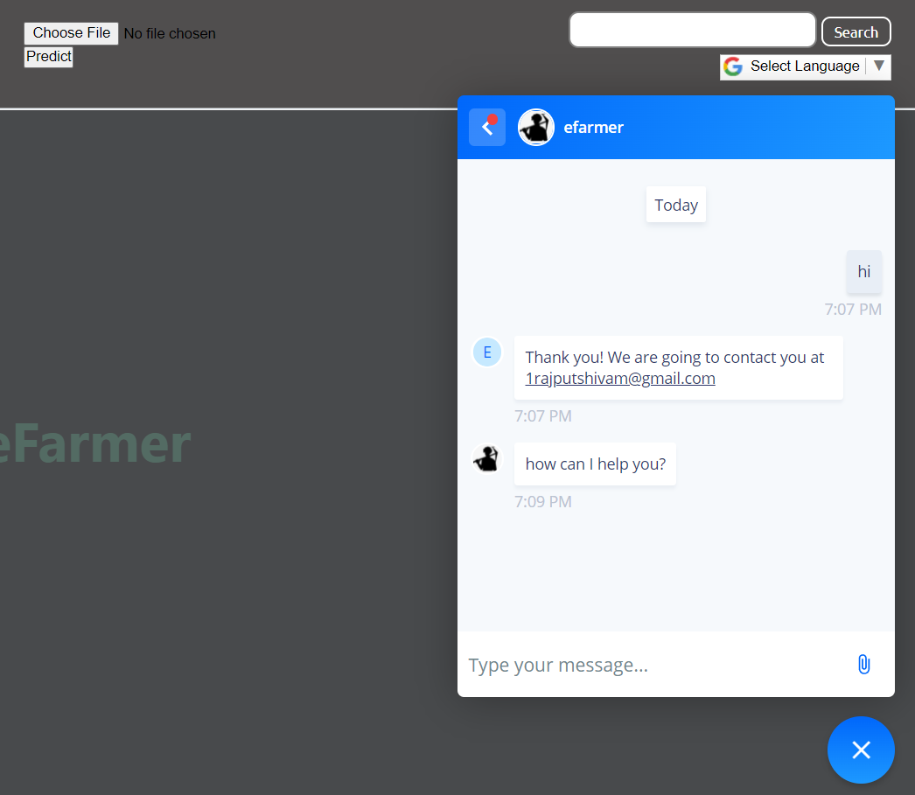
Live chat

Slide 14
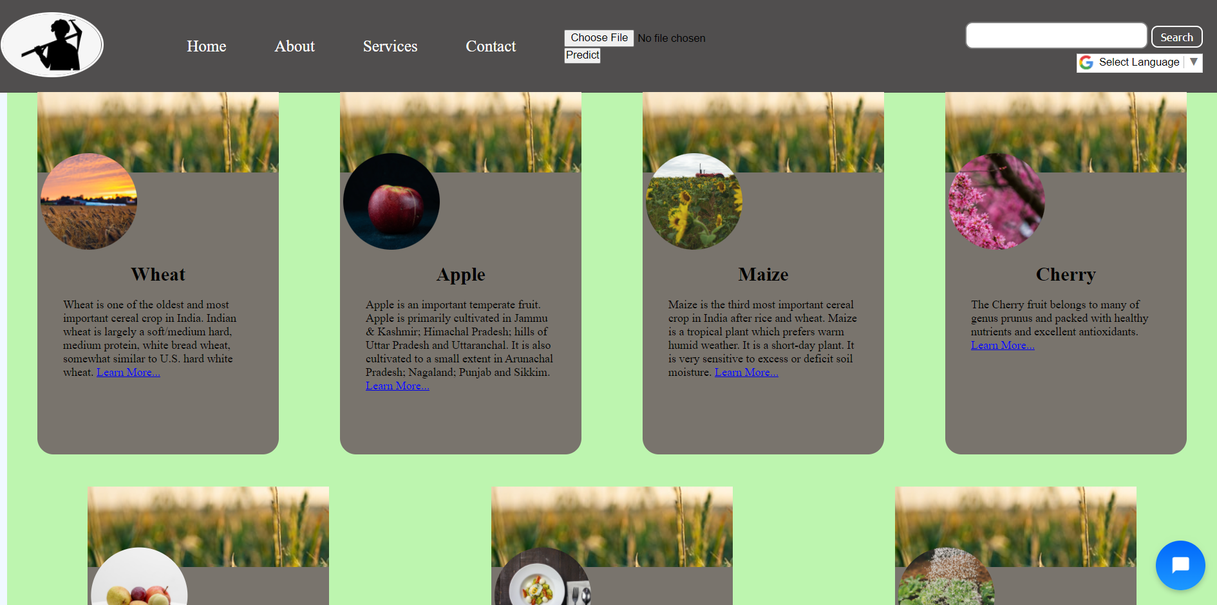
Services

Slide 15
Conclusion
We have tested our website on a local server and the website is responsive.
We have uploaded the image as input and started predicting the accuracy was very well.
We have tested live chat and it is responsive so we can give solutions to our users very fast.
The website has a language translator so users can use it in their language.
We are hosting our website on Amazon Web Services (AWS) still working on it.

Slide 16
THANK YOU

